Slide 1
Other Applied AI
COMP 4230
David J Stucki
Fall 2024

Slide 2
Alerts
Read Larson Chapter 16

Slide 3
Game AI
AI for GAMES ≠ AI In General
In fact Game AI should be sub-optimal
  Must be smart, but purposely flawed
  It should add entertainment value, present challenge, but not be invincible
It is not allowed to 'peek behind the curtain'
It must perform in real time (O(1)?)
User perception is paramount
Most Game AI is focused around agents
  NPCs, whether enemy, ally, or neutral
It needs to have the same limitations/constraints as the human player
  Vision, Hearing, Communication, Reaction time, etc.
Goals
Beliefs
Emotions
Player
Game

Slide 4
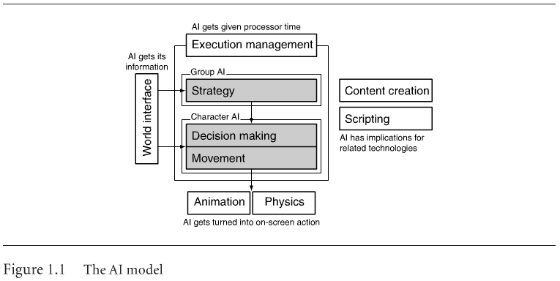
Game AI
Artificial Intelligence for Games, Ian Millington and John Funge, CRC Press, 2009, p. 9.

Slide 5
Bayesian Reasoning
A Bayesian network is made up of:
A
1. A Directed Acyclic Graph
B
C
D
2. A set of tables for each node in the graph
A | P(A)
false | 0.6
true | 0.4
A | B | P(B|A)
false | false | 0.01
false | true | 0.99
true | false | 0.7
true | true | 0.3
B | D | P(D|B)
false | false | 0.02
false | true | 0.98
true | false | 0.05
true | true | 0.95
B | C | P(C|B)
false | false | 0.4
false | true | 0.6
true | false | 0.9
true | true | 0.1

Slide 6
A Directed Acyclic Graph
Each node in the graph is a random variable
A node X is a parent of another node Y if there is an arrow from node X to node Y eg. A is a parent of B
A
B
C
D
Informally, an arrow from node X to node Y means X has a direct influence on Y

Slide 7
A Set of Tables for Each Node
A | P(A)
false | 0.6
true | 0.4
A | B | P(B|A)
false | false | 0.01
false | true | 0.99
true | false | 0.7
true | true | 0.3
Each node X_{i} has a conditional probability distribution P(X_{i} | Parents(X_{i})) that quantifies the effect of the parents on the node
The parameters are the probabilities in these conditional probability tables (CPTs)
B | C | P(C|B)
false | false | 0.4
false | true | 0.6
true | false | 0.9
true | true | 0.1
A
B
B | D | P(D|B)
false | false | 0.02
false | true | 0.98
true | false | 0.05
true | true | 0.95
C
D

Slide 8
Inference
Using a Bayesian network to compute probabilities is called inference
In general, inference involves queries of the form:
P( X | E )
E = The evidence variable(s)
X = The query variable(s)

Slide 9
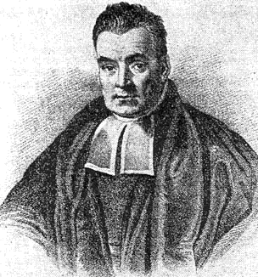
Bayes’ Theorem
$$P\left(B | A\right)=\frac{P(A|B)∙P(B)}{P(A)}$$
where A and B are events.
P(A) and P(B) are the probabilities of A and B independent of each other.
P(A|B), a conditional probability, is the probability of A given that B is true.
P(B|A), is the probability of B given that A is true.

Slide 10
Inference
HasAnthrax
HasCough
HasFever
HasDifficultyBreathing
HasWideMediastinum
An example of a query would be:
P( HasAnthrax| HasFever and HasCough)
Note: Even though HasDifficultyBreathing and HasWideMediastinum are in the Bayesian network, they are not given values in the query (ie. they do not appear either as query variables or evidence variables)
They are treated as unobserved variables

Slide 11
The Bad News
Exact inference is feasible in small to medium-sized networks
Exact inference in large networks takes a very long time
We resort to approximate inference techniques which are much faster and give pretty good results

Slide 12
Person Model (Initial Prototype)
Anthrax Release
Time Of Release
Location of Release
…
…
Female
20-30
Gender
50-60
Male
Age Decile
Age Decile
Gender
Home Zip
Home Zip
Anthrax Infection
Other ED
Disease
Anthrax Infection
Other ED
Disease
15213
15146
Respiratory
from Anthrax
Respiratory CC
From Other
Respiratory
from Anthrax
Respiratory CC
From Other
Respiratory
CC
Respiratory
CC
ED Admit
from Anthrax
ED Admit
from Other
ED Admit
from Anthrax
Unknown
ED Admit
from Other
False
Respiratory CC
When Admitted
Respiratory CC
When Admitted
Yesterday
ED Admission
never
ED Admission

Slide 13
Bayesian Networks
HasAnthrax
HasCough
HasFever
HasDifficultyBreathing
HasWideMediastinum
In the opinion of some AI researchers, Bayesian networks are the most significant contribution in AI in the 90s and 2000s
They are used in many applications, e.g., spam filtering, speech recognition, robotics, diagnostic systems and even syndromic surveillance

Slide 14
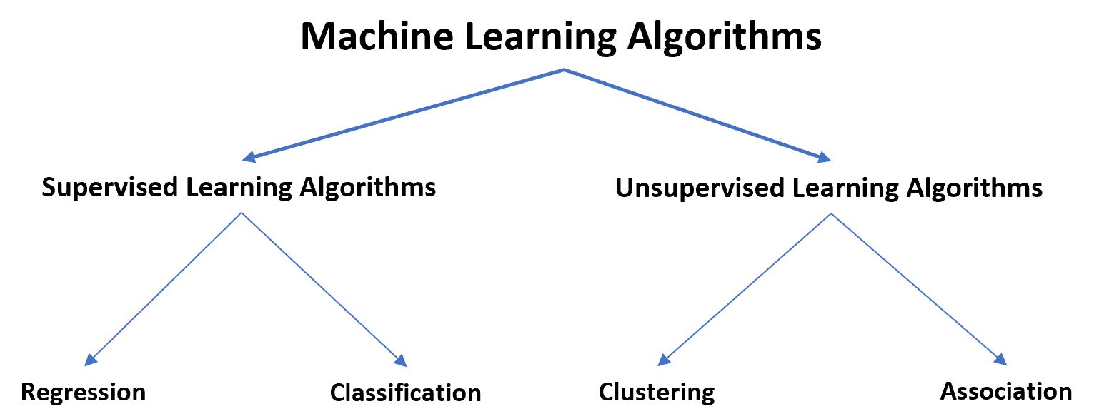
Machine Learning

Slide 15
Supervised Learning (with thanks to Yashi Hu and Brendon Pittman)
Input variables(X) and an output(Y)
Goal: approximate mapping function so well that output variables(Y) can be predicted with new input data(X)
Further grouped into regression and classification problems
  Classification: Output variable is a category
  Regression: Output variable is a real value
Most common technique for training neural networks and decision trees

Slide 16
Unsupervised Learning
Only input data(X)
Goal: Have computer learn how to do something that we do not tell it how to
Two approaches:
  Some sort of reward system
  Clustering

Slide 17
Some Sort of Reward System
Teach the agent by using some sort of reward system to indicate success
A form of reinforcement learning
  You cannot tell it what to do, but you can reward/punish it if it does the right/wrong thing
  It has to figure out what it did that made it get the reward/punishment
Goal: Maximize its rewards

Slide 18
Clustering
Goal: Find similarities in the training data
Example: Clustering individuals based on demographic might result in a clustering of the wealthy in one group and the poor in another

Slide 19
K - Means Clustering
Partition n objects into k clusters in which each object belongs to the cluster with the nearest mean
Algorithm:
Clusters the data into k groups where k is predefined
Select k points at random as cluster centers
Assign objects to their closest cluster center according to the Euclidean distance function
Calculate the centroid or mean of all objects in each cluster
Repeat steps 2, 3, and 4 until the same points are assigned to each cluster in consecutive rounds

Slide 20
K - Means Clustering Example
Data Set: 15, 15, 16, 19, 19, 20, 20, 21, 22, 28, 35, 40, 41, 42, 43, 44, 60, 61, 65
Initial Clusters:
Centroid (C1) = 16 [16]
Centroid (C2) = 22 [22]
Iteration 1:
C1 = 15.33 [15, 15, 16]
C2 = 36.25 [19, 19, 20, 20, 21, 22, 28, 35, 40, 41, 42, 43, 44, 60, 61, 65]
.
.
.
Iteration 3:
C1 = 19.50 [15, 15, 16, 19, 19, 20, 21, 22, 28]
C2 = 47.89 [35, 40, 41, 42, 43, 44,60, 61, 65]
Iteration 4:
C1 = 19.50 [15, 15, 16, 19, 19, 20, 21, 22, 28]
C2 = 47.89 [35, 40, 41, 42, 43, 44,60, 61, 65]

Slide 21
Dimension Reduction
Dimension reduction is reducing the number of variables or features that are being considered in a model
Dimension reduction is a core aspect of Feature Extraction

Slide 22
Feature Extraction
Is a dimension reduction process which when given an input will reduce or transform the features of the input to find only the relevant ones
Popularly used for image recognition
  Tons of algorithms to do this
  Each essentially reduces the features of the image to whichever it thinks is most relevant, and uses that feature to compare to the feature of a newly given image, to see if it is a match.

Slide 23
Pros and Cons in Unsupervised learning
Cons
  Since there is no expected output for unsupervised learning algorithms the only way to tell whether it did something correctly is to inspect what it did manually, this is not possible when things are black boxed
Pros
  Can simplify data so that people can understand it better
  Can reduce the number of features in high dimensional data reducing the space and memory needed

Slide 24
Introduction to Evolutionary Computation
Evolutionary Computation is the field of study devoted to the design, development, and analysis of problem solvers based on natural selection (simulated evolution).
Evolution has proven to be a powerful search process.
Evolutionary Computation has been successfully applied to a wide range of problems including:
  Aircraft Design
  Routing in Communications Networks
  Tracking Windshear
  Game Playing (Checkers [Fogel], Tic-Tac-Toe [Angeline])

Slide 25
Introduction to Evolutionary Computation
An Example Evolutionary Computation
Procedure EC{
t = 0;
Initialize Pop(t);
Evaluate Pop(t);
While (Not Done)
{
Parents(t) = Select_Parents(Pop(t));
Offspring(t) = Procreate(Parents(t));
Evaluate(Offspring(t));
Pop(t+1)= Replace(Pop(t),Offspring(t));
t = t + 1;
}

Slide 26
Introduction to Evolutionary Computation
In an Evolutionary Computation, a population of candidate solutions (CSs) is randomly generated.
Each of the CSs is evaluated and assigned a fitness based on a user specified evaluation function. The evaluation function is used to determine the ‘goodness’ of a CS.
A number of individuals are then selected to be parents based on their fitness. The Select_Parents method must be one that balances the urge for selecting the best performing CSs with the need for population diversity.
The selected parents are then allowed to create a set of offspring which are evaluated and assigned a fitness using the same evaluation function defined by the user.
Finally, a decision must be made as to which individuals of the current population and the offspring population should be allowed to survive. Typically, in EC , this is done to guarantee that the population size remains constant.

Slide 27
Introduction to Evolutionary Computation
Once a decision is made the survivors comprise the next generation (Pop(t+1)).
This process of selecting parents based on their fitness, allowing them to create offspring, and replacing weaker members of the population is repeated for a user specified number of cycles.
Stopping conditions for evolutionary search could be:
  The discovery of an optimal or near optimal solution
  Convergence on a single solution or set of similar solutions,
  When the EC detects the problem has no feasible solution,
  After a user-specified threshold has been reached, or
  After a maximum number of cycles.

Slide 28
A Brief History of Evolutionary Computation
The idea of using simulated evolution to solve engineering and design problems have been around since the 1950’s (Fogel, 2000).
  Bremermann, 1962
  Box, 1957
  Friedberg, 1958
However, it wasn’t until the early 1960’s that we began to see three influential forms of EC emerge (Back et al, 1997):
  Evolutionary Programming (Lawrence Fogel, 1962),
  Genetic Algorithms (Holland, 1962)
  Evolution Strategies (Rechenberg, 1965 & Schwefel, 1968),

Slide 29
A Brief History of Evolutionary Computation
The designers of each of the EC techniques saw that their particular problems could be solved via simulated evolution.
  Fogel was concerned with solving prediction problems.
  Rechenberg & Schwefel were concerned with solving parameter optimization problems.
  Holland was concerned with developing robust adaptive systems.

Slide 30
A Brief History of Evolutionary Computation:
The Evolution of Evolutionary Computation
First Generation EC
  EP (Fogel)
  GA (Holland)
  ES (Rechenberg, Schwefel)
Second Generation EC
  Genetic Evolution of Data Structures (Michalewicz)
  Genetic Evolution of Programs (Koza)
  Hybrid Genetic Search (Davis)
  Tabu Search (Glover)

Slide 31
A Brief History of Evolutionary Computation:
The Evolution of Evolutionary Computation
Third Generation EC
  Artificial Immune Systems (Forrest)
  Cultural Algorithms (Reynolds)
  DNA Computing (Adleman)
  Ant Colony Optimization (Dorigo)
  Particle Swarm Optimization (Kennedy & Eberhart)
  Memetic Algorithms
  Estimation of Distribution Algorithms
Fourth Generation
  ????

